Slide 1

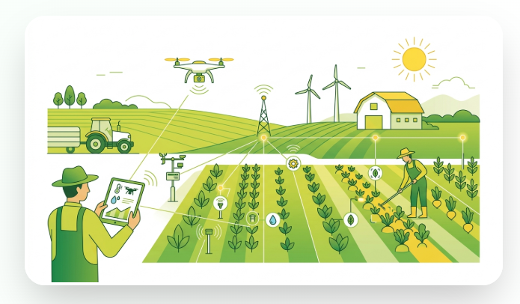

FarmVerse
SMART AGRICULTURE PLATFORM
AI POWERED FARM MANAGEMENT
FarmVerse
Intelligent farm operations platform with a smart Agro-Precision system
MENTOR
TEAM MEMBERS
Mr. Vinay Prashant
Ananya C.Y.
Arindam Pal
Arfa Banu
Bhagyesh Patil
Shaik Kousar Bee

Slide 2




PROBLEM STATEMENT & OBJECTIVES
Farming Challenges & Project Goals
No Centralized Data
Limited Market Access
Farm information is fragmented with no single source of truth.
Farmers lack timely access to real-time crop pricing for selling decisions.
Manual Record-Keeping
Inefficient Monitoring
Farm and crop data tracked on paper or scattered spreadsheets, prone to loss and error.
No easy way to track multiple farms and crop health at once.
FarmVerse
02

Slide 3
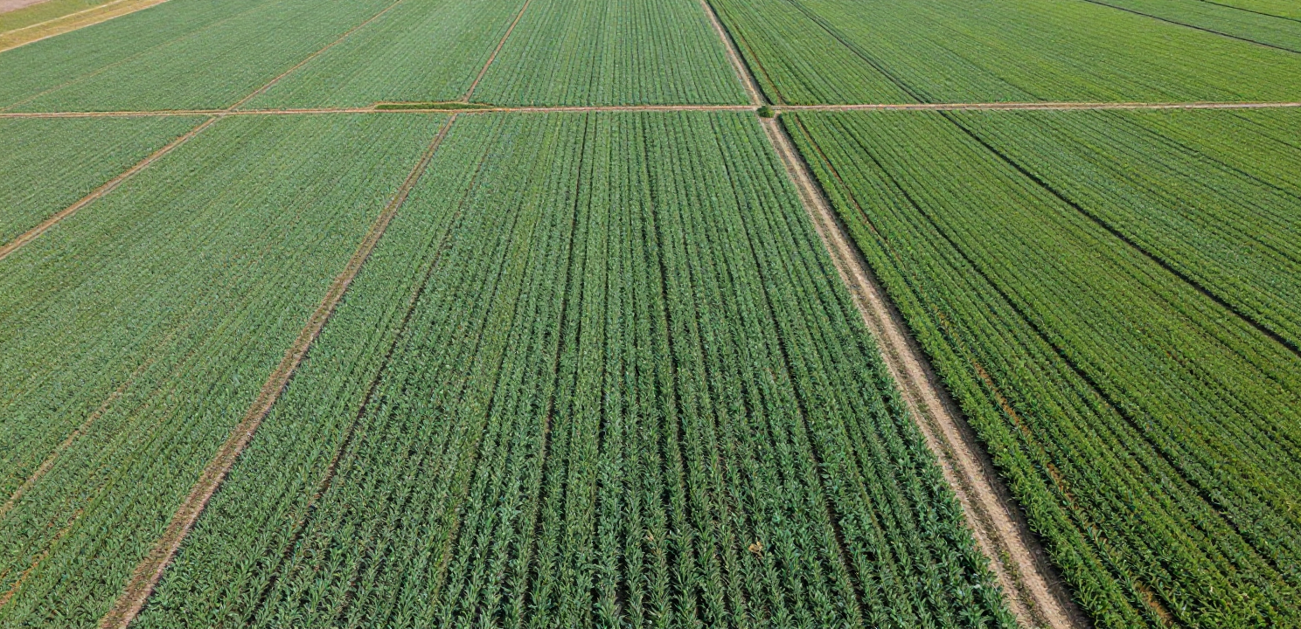




PLATFORM OVERVIEW & CAPABILITIES
Proposed Solution & Key Features
Role-Based Access
Secure registration & login for Farmers and Admins with distinct permissions.
Dashboard & Market Prices
Live farm statistics alongside real-time crop pricing to guide selling decisions.
Farm & Crop Management
Add, update, and track multiple farms; monitor crop types, growth stage & health.
AI-Ready Architecture
Backend designed to plug in AI-powered farming tools as the platform matures.
FarmVerse
03

Slide 4









SYSTEM ARCHITECTURE & TECH STACK
Technical Overview
React.js
Spring Boot
JWT
PostgreSQL
Frontend UI
Backend & REST APIs
Authentication
Supabase Cloud DB
REQUEST FLOW
Client
Controller Layer
Service Layer
Data Transfer Objects
Supabase DB
React.js
REST Endpoints
Business Logic
Validation & Response
PostgreSQL · JPA
JWT Authentication Filter secures every request before it reaches the Service Layer · Role-based access: Farmer / Admin
FarmVerse
04

Slide 5
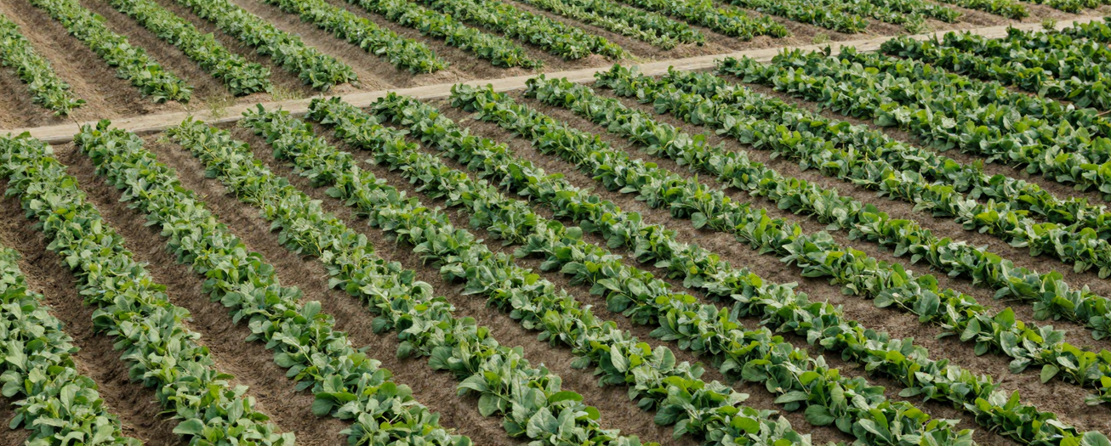



DATABASE DESIGN & TEAM PROGRESS
Data Schema & Current Status
Users Table
Credentials & profiles linked to farms.
Farms Table
Farm info linked to users (1 User → Many Farms).
PROGRESS
Schema design complete
Crops Table
Crop details linked to farms (1 Farm → Many Crops).
Supabase database live
Backend fully integrated
FarmVerse
05

Slide 6
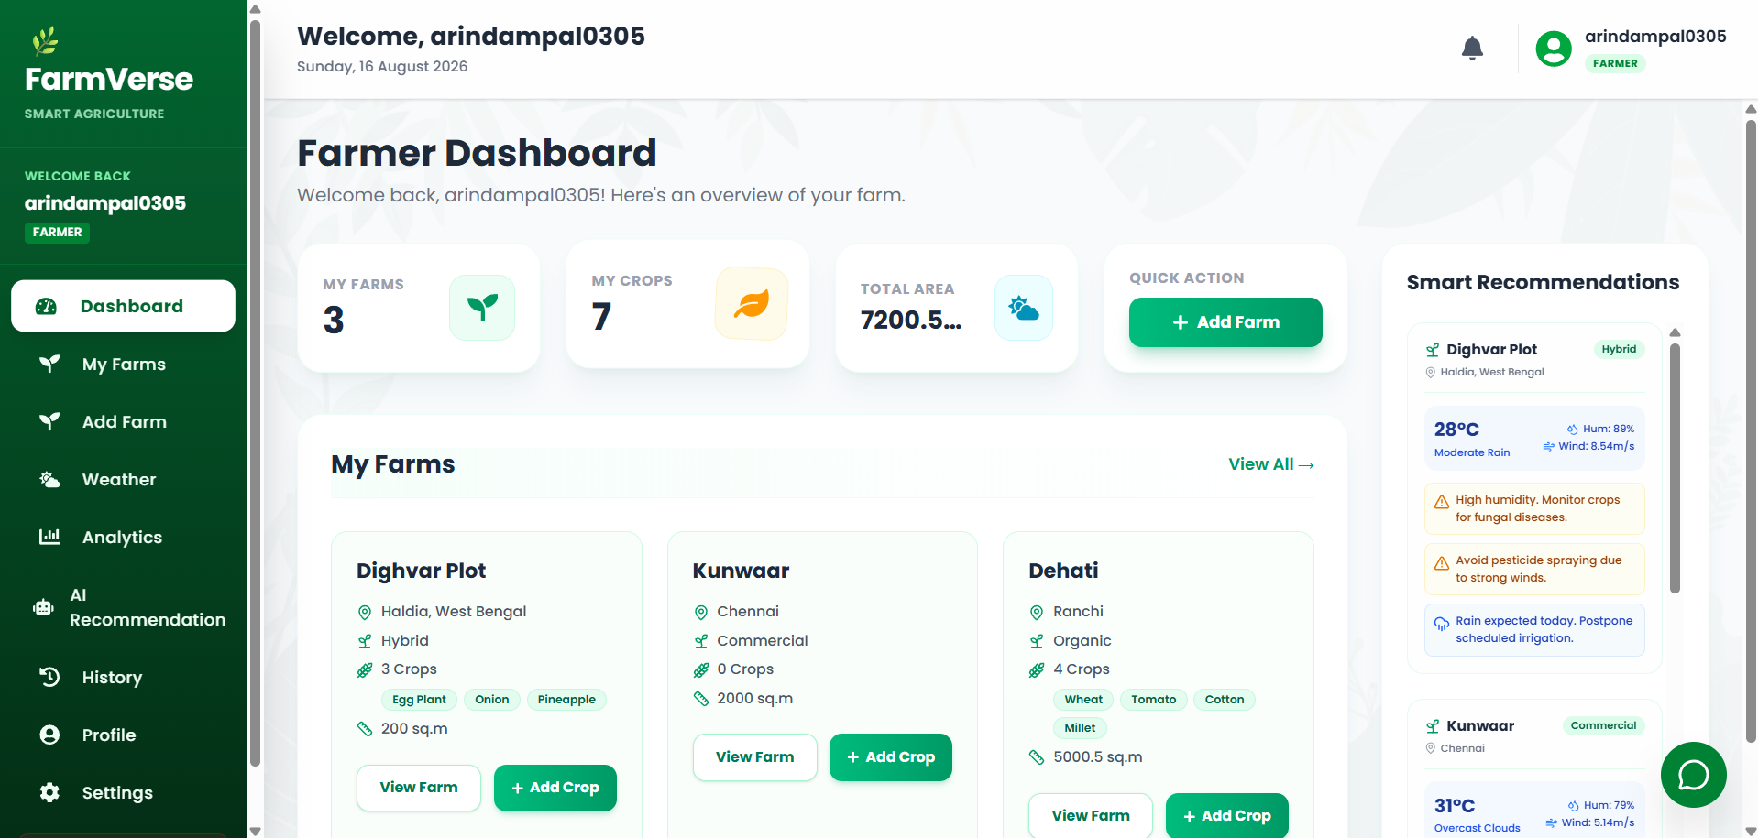
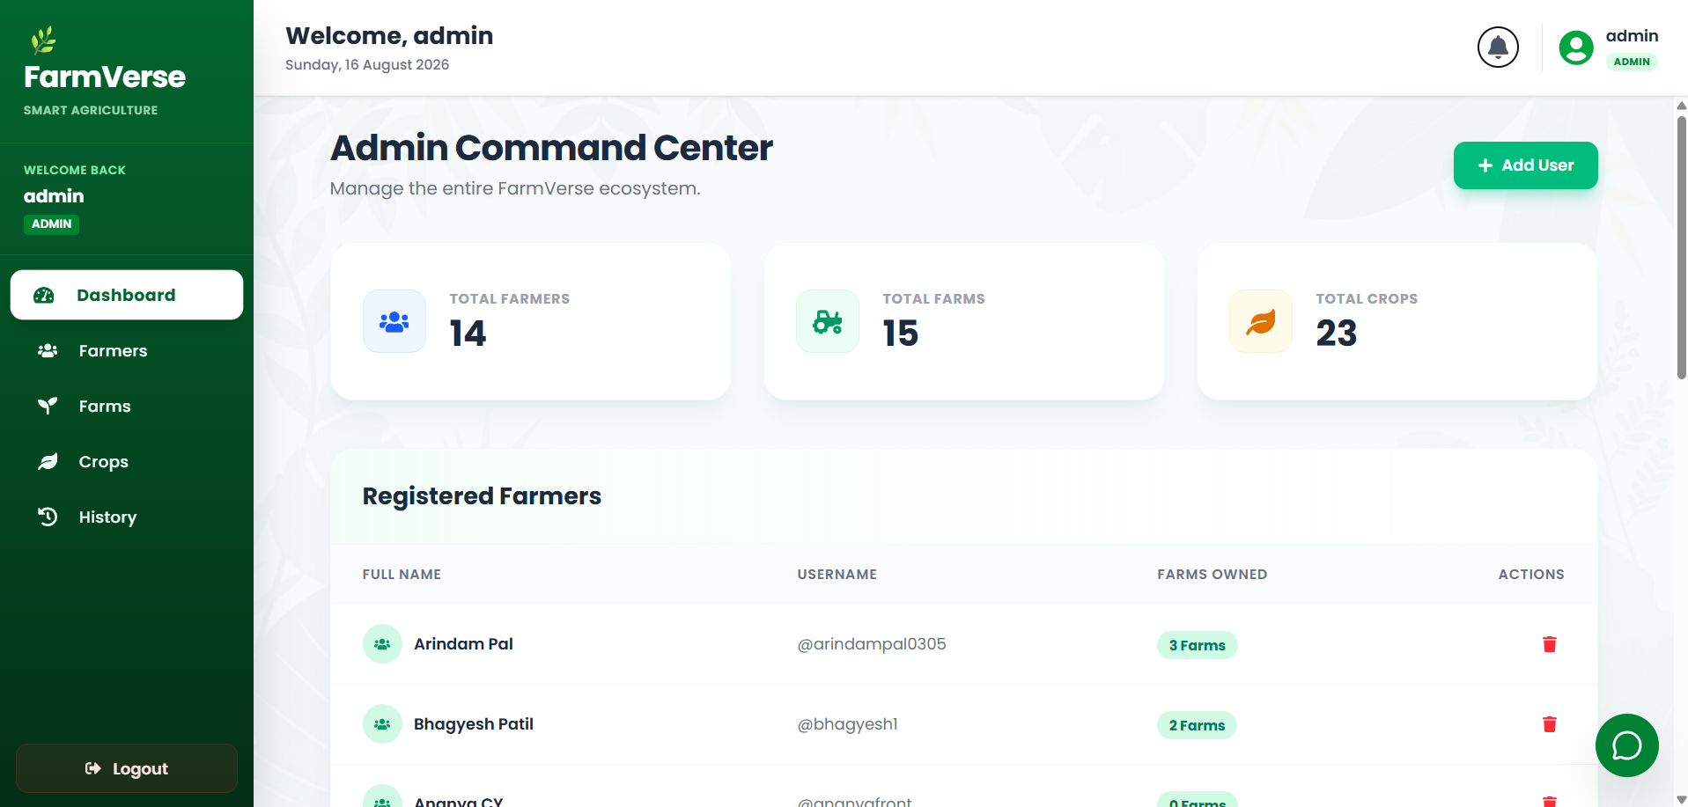
PLATFORM INTERFACE SHOWCASE
Application Screenshots
A visual walkthrough of the FarmVerse platform, highlighting the Farmer Dashboard and AI-powered recommendations for intuitive farm management.
Farmer Dashboard
AI Recommendation Engine
Live Farm & Crop Stats
AI-Powered Recommendations
Role-Based Farmer UI
FarmVerse
06

Slide 7
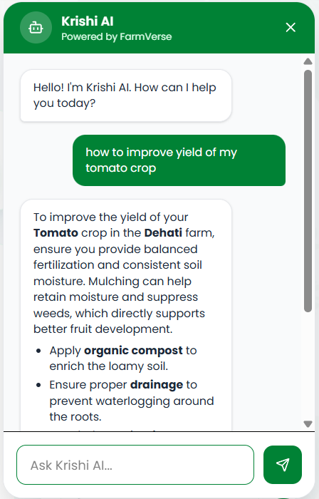





AI FEATURES & FUTURE SCOPE
Krishi AI: Conversational Farming Assistant
Krishi AI
AI-powered chatbot for FarmVerse
Krishi AI is a personalized assistant that answers every farmer question with relevancy and accuracy. Strong guardrails and context injection keep it reliable and tailored to each user.
FUTURE SCOPE
Market Price Prediction
Voice Assistant
Mobile Application
Precision Farming
FarmVerse
07

Slide 8
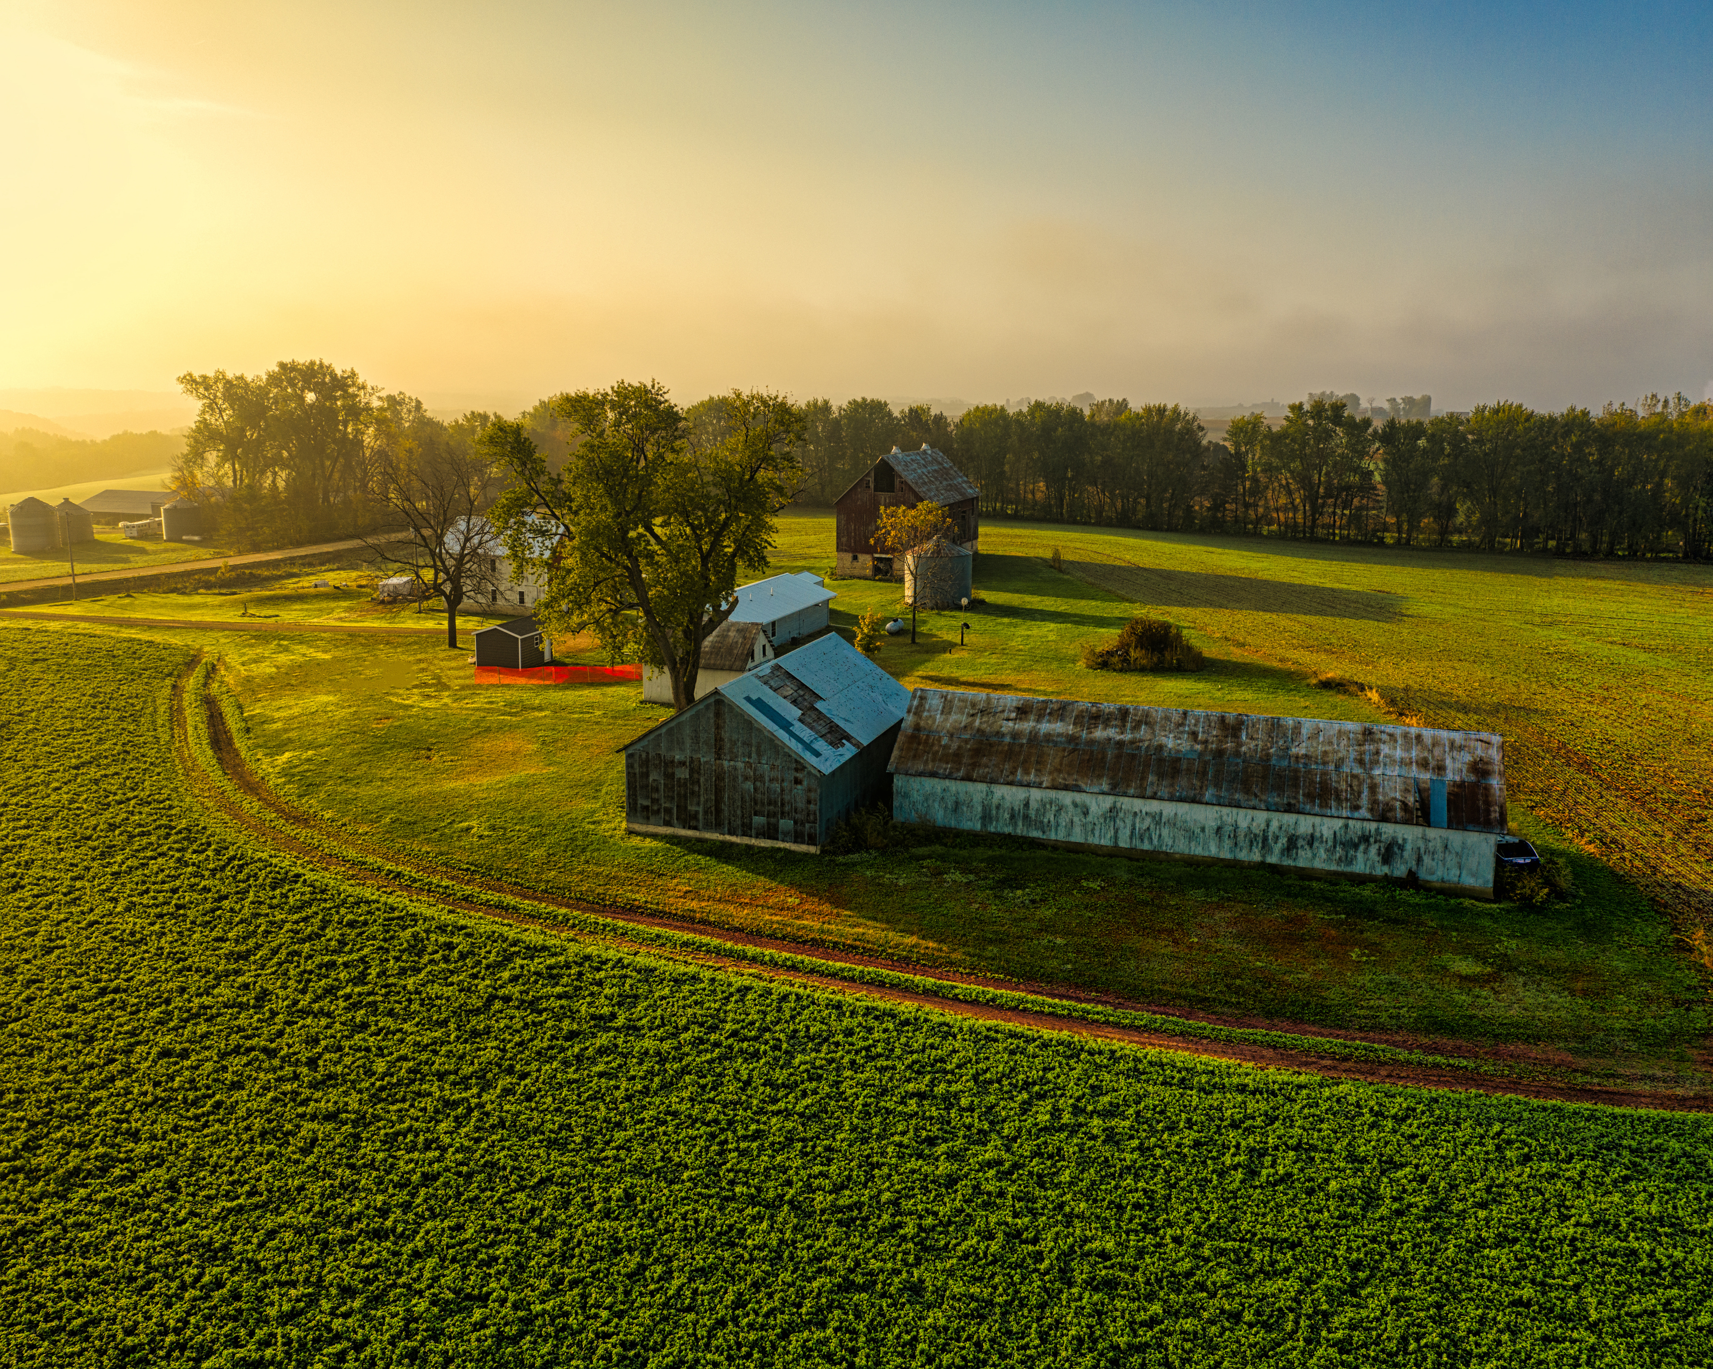


FarmVerse
Thank You!
FarmVerse: Digital farming, powered by intelligence.
Digital Farming Transformation
Secure & Scalable Architecture
AI-Ready Precision Agriculture
FarmVerse
08

